Slide 1
Java mini Project
“E-सहाय”
Submitted in partial fulfillment of the requirement for Degree in Bachelor of Engineering (Information Technology)
By
AMAY RAVI TRIPATHI (5019160)
CRISTON CONRAD LOBO (5019132)
JIGNESH SHAILESH MATHURE (5019137)
Guided by:
Prof. CHETANA BADGUJAR
Department of Information Technology
Fr. Conceicao Rodrigues Institute of Technology
Sector 9A, Vashi, Navi Mumbai – 400703
University of Mumbai 2019-2020
Department of Information Technology
1

Slide 2

E-SAHAYA AN ONLINE GRIEVANCE REPORTING APP

Slide 3
INDEX

Slide 4
SR | TOPIC | PAGE
1 | INTRODUCTION | 6
 | ABSTRACT | 7
 | MOTIVATION | 8
 | - PROBLEM STATEMENT | 9
 | - SCOPE | 10
2 | LITERATURE SURVEY | 11
 | - ANALYSIS | 12
 | - RESEARCH | 13
 | - SURVEY | 14
 | - STATISTICS | 15
 | - EXISTING SYSTEM | 16
 | - REQUIREMENT ANALYSIS | 17

Slide 5
SR | TOPIC | PAGE
3 | SYSTEM DESIGN | 18
 | FLOWCHART | 19
4 | IMPLEMENTATION DETAILS | 20
 | - SYSTEM REQUIREMENTS | 21
 | - SOLUTION APRROACH / METHODOLOGY | 22
5 | EXPERIMENTAL RESULTS | 23
 | SCREENSHOTS | 24
6 | CONCLUSION AND FUTURE SCOPE | 27
7 | REFERENCES | 29
8 | ACKNOWLEDGEMENTS | 31
9 | THANK YOU PAGE | 32

Slide 6
1. INTRODUCTION

Slide 7
1.1 ABSTRACT
In today’s World, progressive countries like Denmark, Sweden, Switzerland, New Zealand, Norway, etc. have achieved more than 96% of Digitalization in the Governing system [1].
This makes governing a lot easier. A major part of this is grievance reporting. So we have decided to make a local authority grievance website. In the current generation, crowdsourcing can be achieved in a relatively hassle-free yet effective means of collecting data from large source pool [2], i.e. people in a locality. We are going to collect the location, image and the type of problem in order to register a complaint. Also, we are going to implement a login system so as to ensure the authenticity of the report registered.

Slide 8
1.2 MOTIVATION
Our Project was motivated by the influential program ‘DIGITAL INDIA’ launched by Hon. Prime Minister Shree Narendra Modi [3].
We too, have a dream where all the work related to Governance should be converted to an online system as it would save a lot of resources, be easier for both, the authorities and the citizens and also will be Environment Friendly.
Bringing digitization in our Governance will usher in a new era of Transparency, and will also be beneficial to our citizens.
As a Digitized Governance is a sign of a Progressive Country, this would put India on the Global Map along with likes of Countries like Germany, Sweden, Denmark, Singapore, Australia, New Zealand, Japan, etc. who are known for their digital Governance and satisfaction of their citizens.

Slide 9
1.3 PROBLEM STATEMENT
The existing system has many flaws and most of the people using it are not contended.
They face difficulties like standing in queues, provision of physical documents, limited working hours of the administrative office, improper redressal, etc.

Slide 10
1.4 SCOPE
We have decided to make an online reporting system for the people of a locality.
This will include reporting the type of grievances with the help of images efficiently instead of a file system.
We aim to make this process easy and efficient for the people.
This will also ensure that people will actively respond to this instead of blaming the local authorities for keeping a tedious process.

Slide 11
2. LITERATURE SURVEY

Slide 12
2.1 ANALYSIS
Growth in Population has led to growth in technology. According to a survey conducted by Harvard University in 2016, in the United Kingdom (U.K.), the United States (U.S.) and Australia, many citizens are already conducting more than half of their interactions with the Government digitally.
Meanwhile, seven in 10 citizens from Metropolitan areas of France, Germany, India, Canada, and Singapore want to increase their digital interactions with the Government, as do 76 percent of citizens surveyed in the Scandinavian Countries.

Slide 13
2.2 RESEARCH
In [5], the main focus is on developing an online complaint registration system in order to replace the offline one present in many countries like India, Philippines, Saudi Arabia, Malaysia, Indonesia, etc.
According to [6], [7] the fact that such an online system will more efficient, user-friendly, economical and also be beneficial for both, the citizens(clients) and the authorities (Admin) is confirmed.
Such a system will efficiently store proper data and can also by the users so as to forward those to the concerned departments.

Slide 14
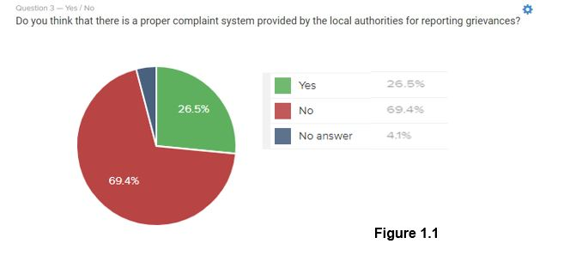
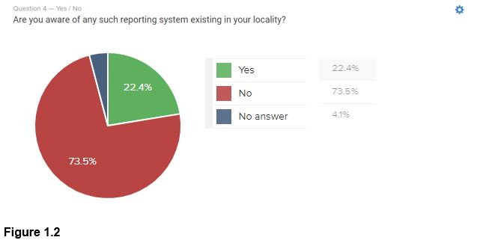
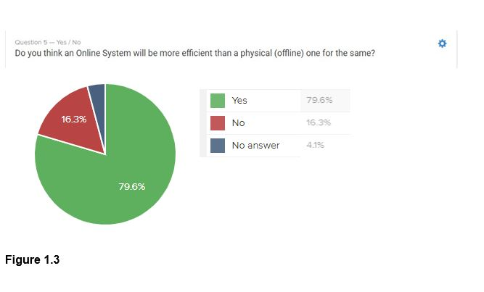
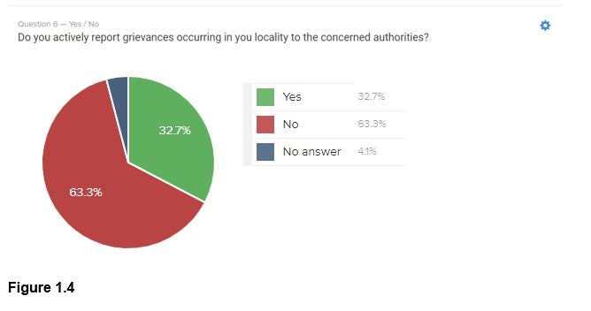
2.3 SURVEY

Slide 15
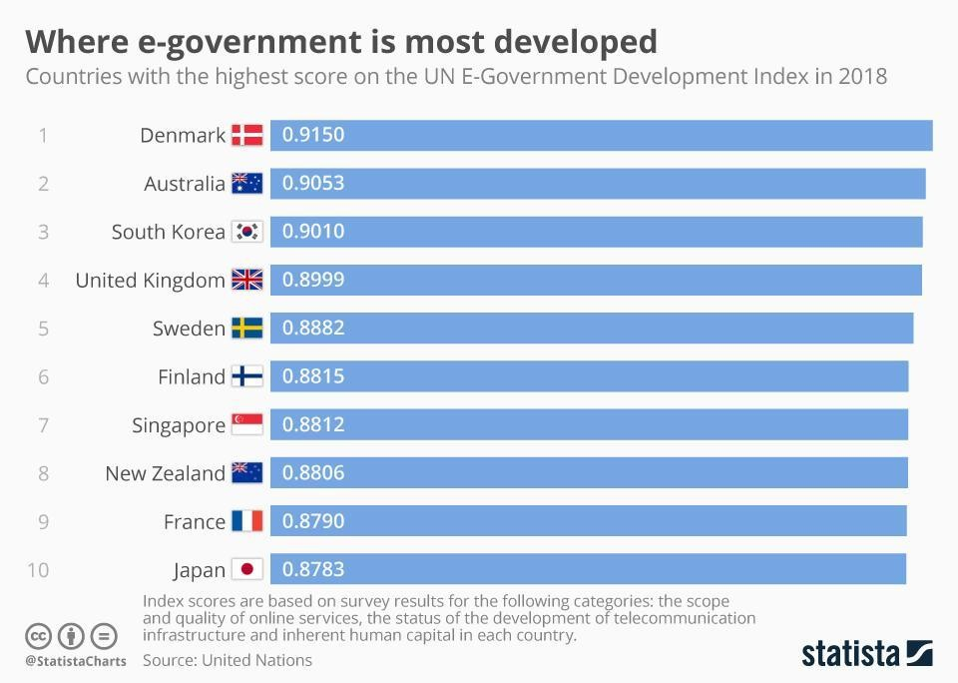
2.4 STATISTICS

Slide 16
2.5 EXISTING SYSTEM
The current system is dealing with a manual basis. People have to go directly to the concerned department or write letters to give their complaints.
It needs a huge amount of paperwork to maintain complaint details.
A huge expenditure and lots of time are spent using the existing system.
Tracking, maintaining and retrieving of data from a stack of papers is a difficult process.

Slide 17
2.6 REQUIREMENT ANALYSIS
Many people think that a transparency in Governance is the most important thing in a Democracy.
This application is viable method of initiating such a transparent governance in a locality.
People can easily register their complaints instead of physically doing the same thing.
The citizens will too, have a sense of vigilance about raising their voice about a problem and actively participate in the Governance.

Slide 18
3. SYSTEM DESIGN

Slide 19
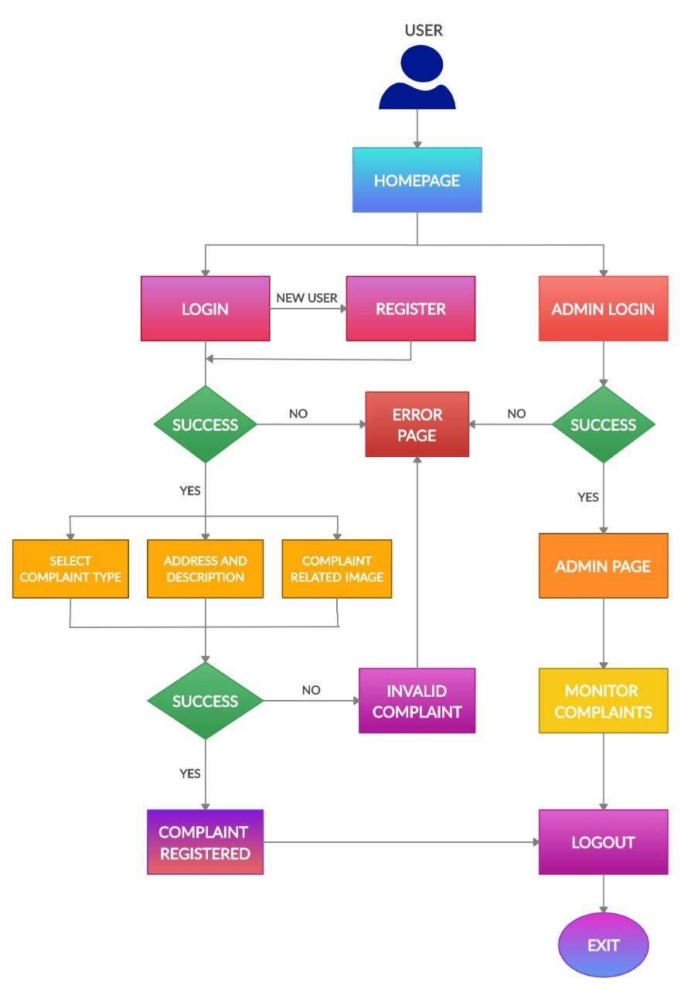
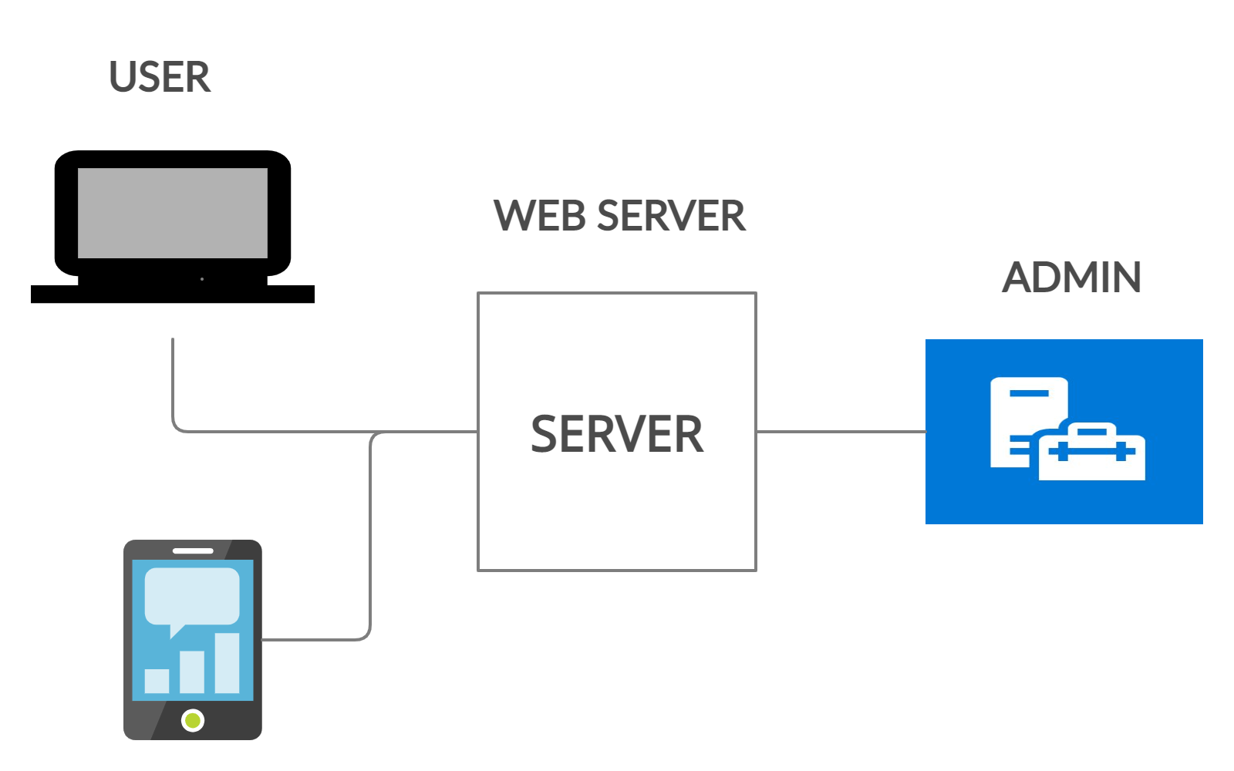
DIAGRAM-A
DIAGRAM-B

Slide 20
4. IMPLEMENTATION DETAILS

Slide 21
4.1 SOFTWARE AND HARDWARE REQUIREMENTS
DEVELOPER
APPLICATIONS –
Java Eclipse IDE, Java JDK 14, MYSQL Workbench , Browser
2. OPERATING SYSTEM –
Windows 7/8/10 or Mac OS or Linux
CLIENT
A good Internet Connection
A Mobile Phone/Camera to take the pictures) Authentic credentials of the user (to verify with Database)
Any Computer Machine can be used as long as it fulfils the above mentioned requirements

Slide 22
4.2 SOLUTION APPROACH AND METHODOLOGY
Considering all the above factors in mind, the proposed system is an online web application.
This system is supposed to control and avoid the limitation of the existing system. It will increase the efficiency by speeding up the process.
The major activities of this grievance system are to receive various types of grievances from citizens, updating the status of complaints and informing the citizens about the action.
This Web Application successfully performs actions like login, registration and orderly storage of data entered by the user.
This Application will indeed help to save resources like human labour, paper work and time required by both, the client and the user to work efficiently.

Slide 23
5. EXPERIMENTAL RESULTS

Slide 24
SCREENSHOTS

Slide 25
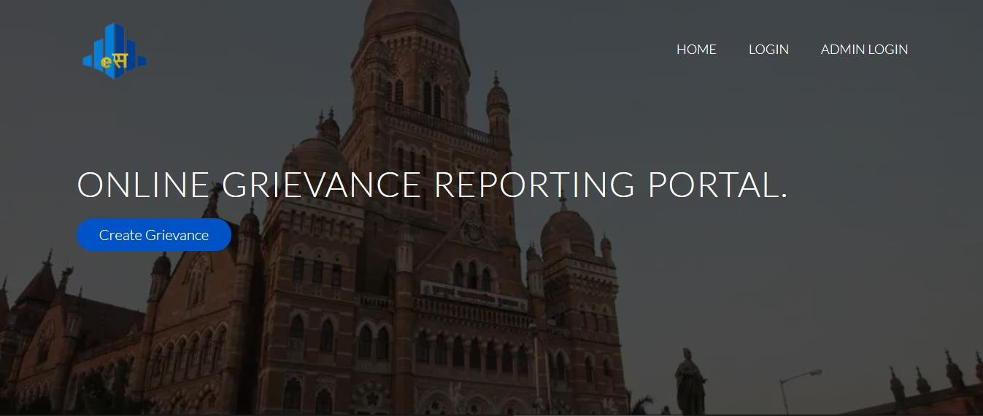
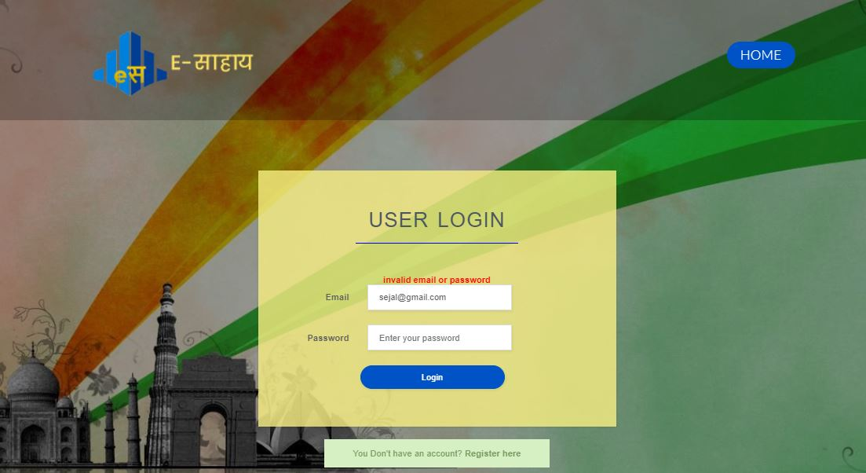
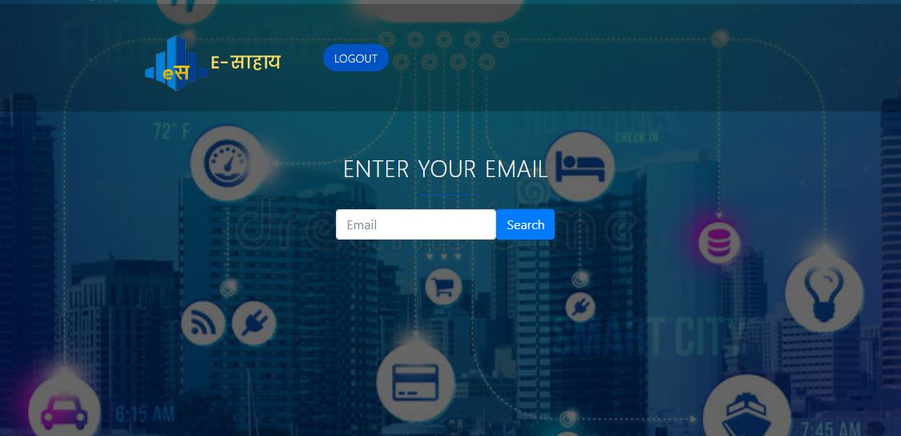
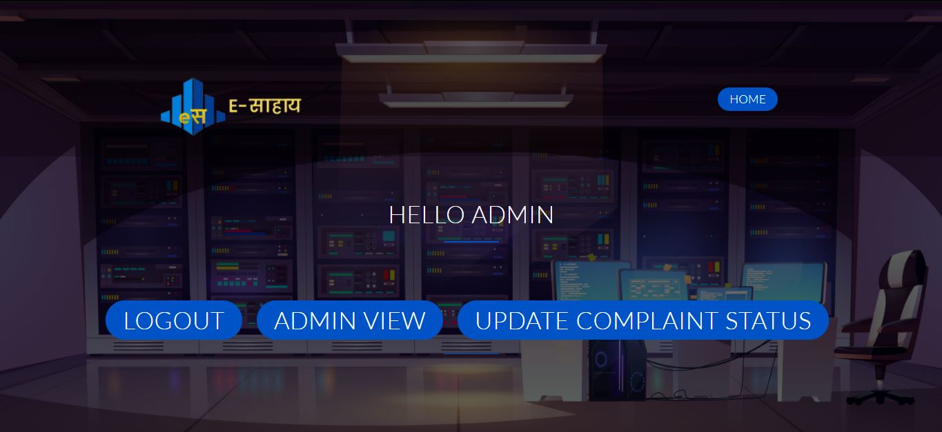

Slide 26
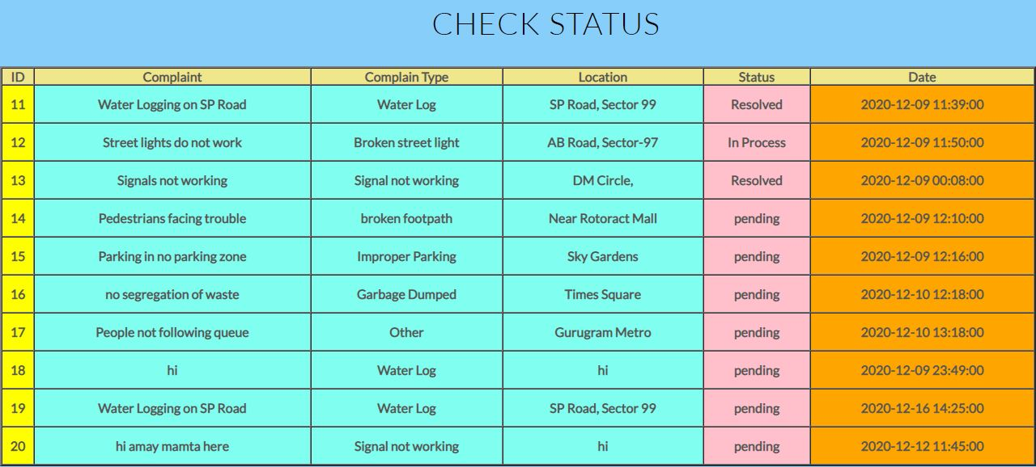
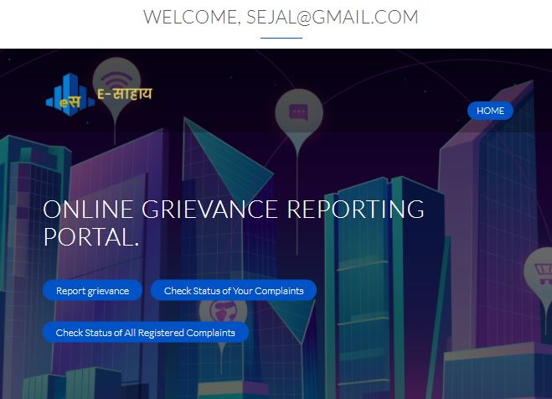
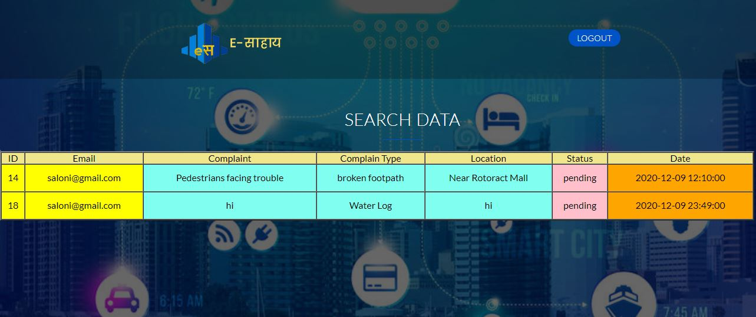
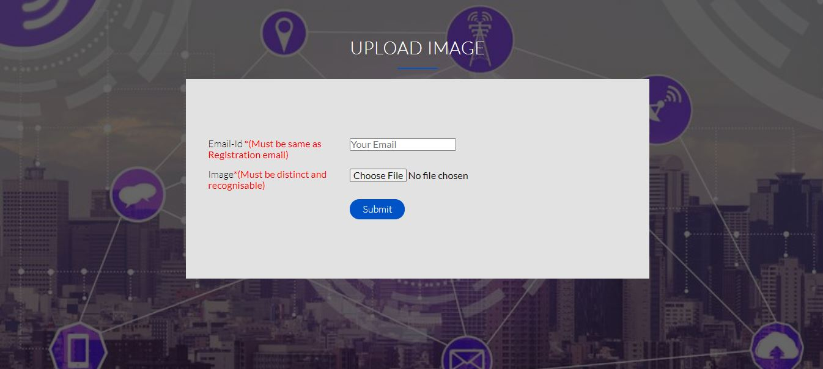

Slide 27
6. CONCLUSION

Slide 28
6.1 CONCLUSION AND FUTURE SCOPE
The implementation of a complaint system in a city has a potential to make a city operations more responsive and efficient.
The direct communication between the municipal corporation and citizens to help in registered problems that citizen facing in urban areas and by continuously track them will result in a clean, peaceful and good environment.
This system is supposed to control and avoid the limitation of the existing system.
In future, additional features like real-time location, biometric authentications, a Chabot and multilingual interface too, implemented.
Also, an Android Application can be made based on this model enabling the user to access using mobile.

Slide 29
7. REFERENCES

Slide 30
7.1 REFERENCES
[1] Kalsi, Nirmaljeet Singh, and Ravi Kiran. "A strategic framework for good governance through e-governance optimization." Program (2015).
[2] Kormpho, Pattamaporn, et al. "Smart complaint management system." 2018 Seventh ICT International Student Project Conference (ICT-ISPC). IEEE, 2018.
[3] Kedar, Maheshkumar Shankar. "Digital India new way of innovating India digitally." International Research Journal of Multidisciplinary Studies 1.4 (2015): 34-49.
[4] Tan, Si Ying, and Araz Taeihagh. "Smart City Governance in Developing Countries: A Systematic Literature Review." Sustainability 12.3 (2020): 899.
[5] Trappey, Amy JC, et al. "A framework of customer complaint handling system." 2010 7th International Conference on Service Systems and Service Management. IEEE, 2010.
[6] Tabassum, Kahkashan, et al. "E-Cops: An Online Crime Reporting and Management System for Riyadh City." 2018 1st International Conference on Computer Applications & Information Security (ICCAIS). IEEE, 2018.
[7] Kandhari, Vishesh K., and Keertika D. Mohinani. "GPS based complaint redressal system." 2014 IEEE Global Humanitarian Technology Conference-South Asia Satellite (GHTC-SAS). IEEE, 2014.

Slide 31
8. ACKNOWLEDGEMENT
We would like to express our gratitude to our college Fr. Conceicao Rodrigues Institute of Technology, Vashi, for giving us the opportunity to undertake this project. We are grateful to our Java Professor, Mr. Anand Pardeshi, our Guide, Mrs. Chetana Badgujar, the Head of the Department Mrs. Dhanashree Hadsul and our Principal, Dr. S.M. Khot for giving us a chance to work on this Project in our course of Engineering. We would also like to thank our parents for their support throughout, and the constant motivation of our friends which has helped us attain successful completion of our first Java project and our proposed system.

Slide 32
THANK YOU!

